Slide 1
User Manual in Verification Platform

Slide 2
注意事項
Please make sure that your code can be compiled successfully with G++ 7.5.0
  Refer to G++ 7.5.0.pptm for the details
Note that submit the code via the platform only if your code is compiled successfully and executed correctly in your local machine via G++ 7.5.0

Slide 3
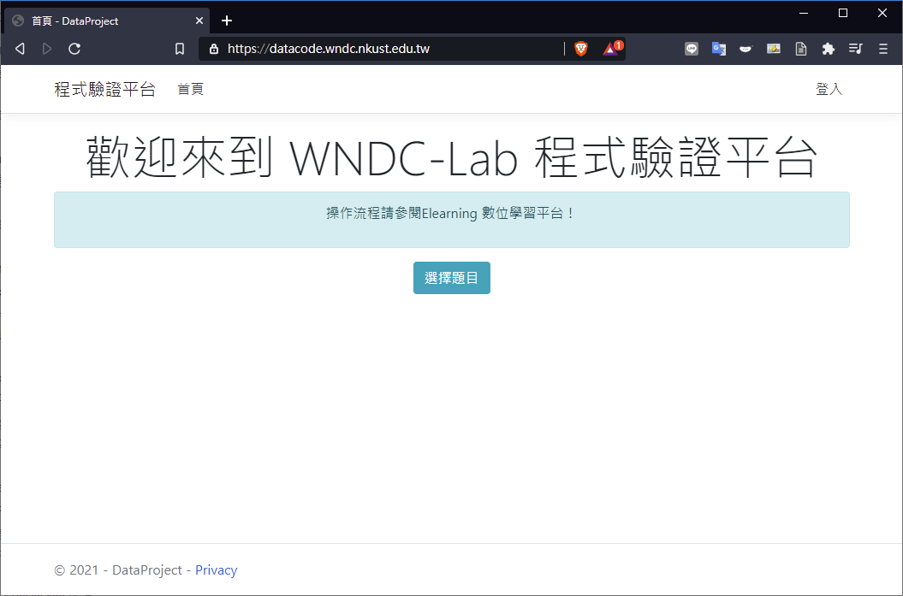
Verification Platform

Slide 4
Instructions

Slide 5
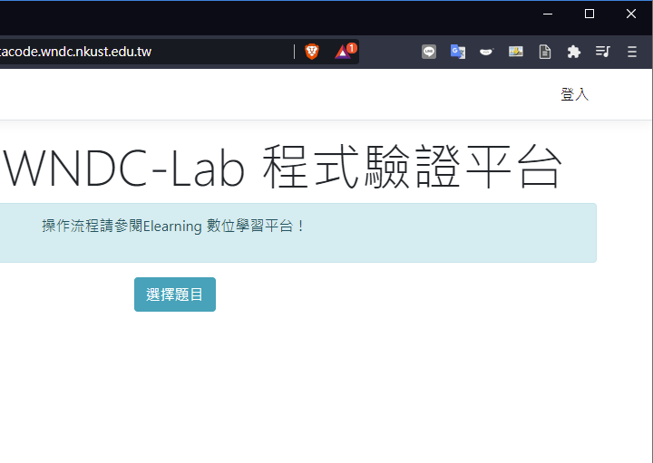
Instructions
Login - 登入

Slide 6
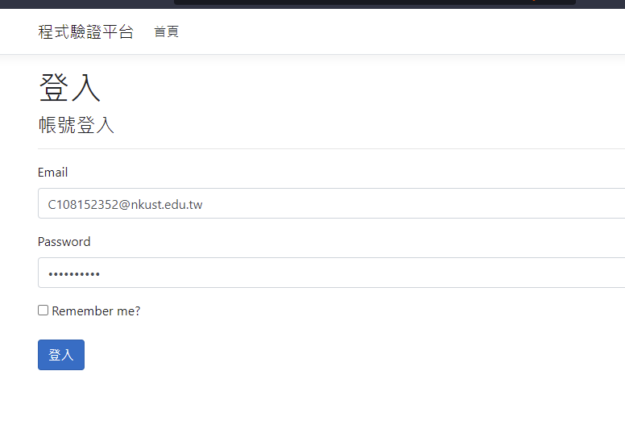
Instructions
Account：
Email address given by school
預設密碼：
P@ss + ID number

Slide 7
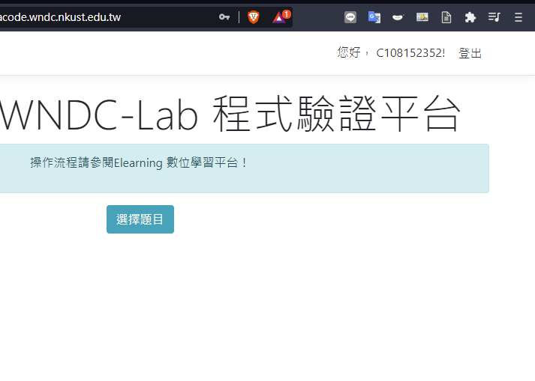
Instructions
After logging in to the website, you can select your questions by the 選擇題目 button.

Slide 8
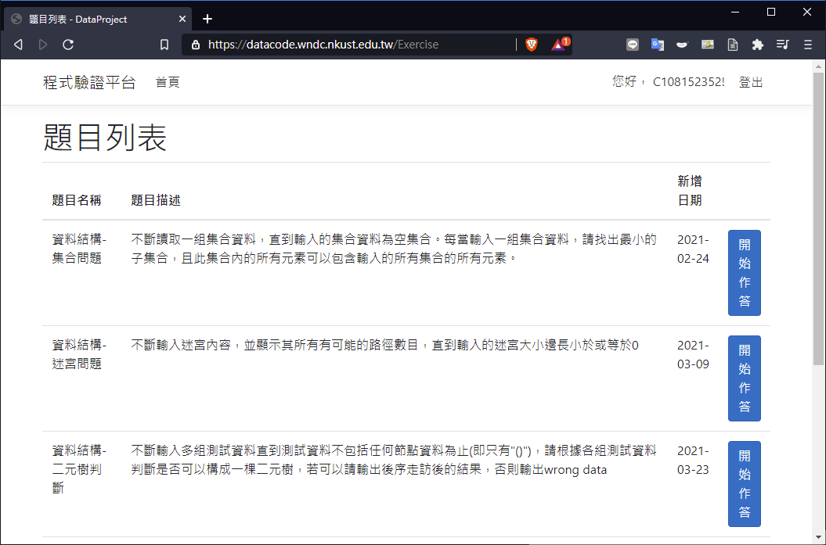
Instructions
Select your question by the name of the course. Then start to submit your code by clicking 開始作答 button.

Slide 9
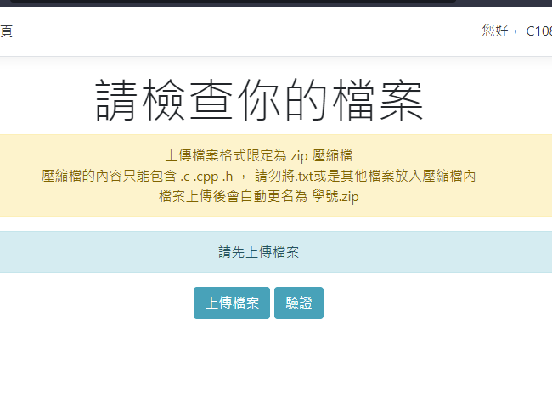
Instructions
Before submitting the code, make sure that you have zipped the code in a zip file. Then submit the zip file via 上傳檔案 button.

Slide 10
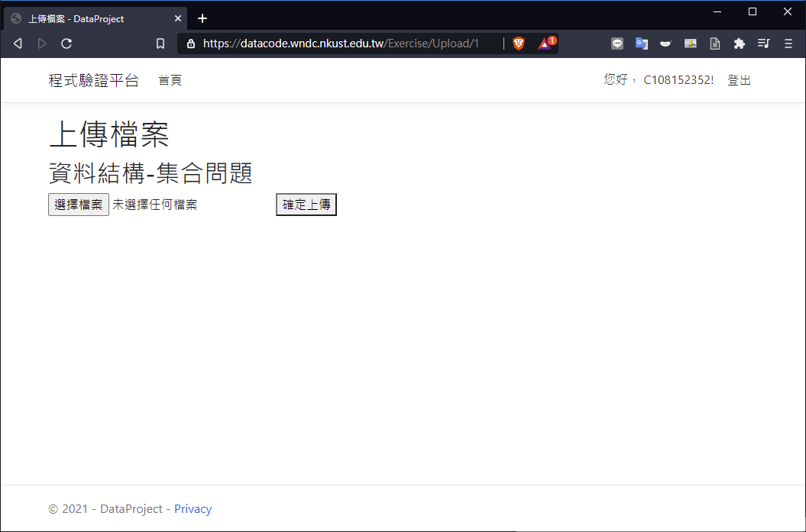
Instructions
Before submitting the file, check if the question name is correct. If ok, submit the file by clicking 選擇檔案 button.

Slide 11
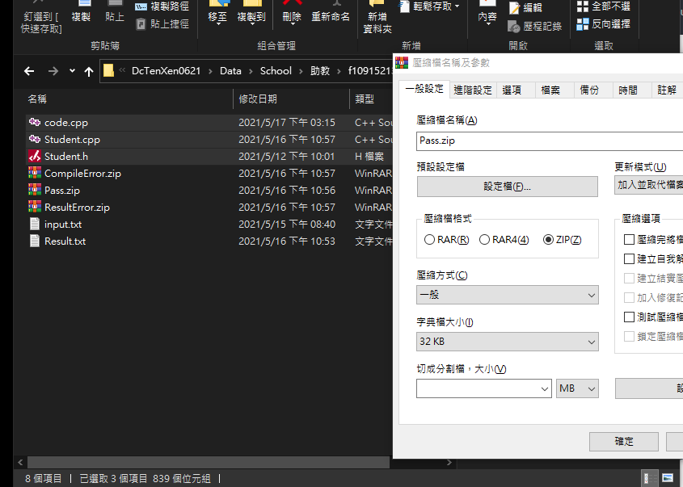
Instructions
Remember to zip your source files (.c, .cpp, .h) into a zip file before submitting the code.

Slide 12
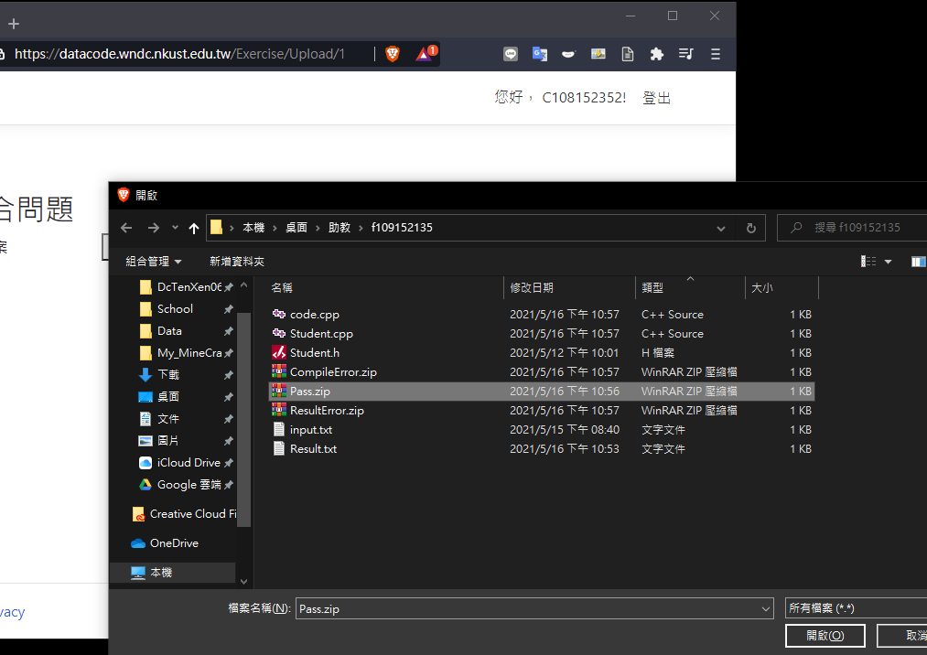
Instructions
Select the zip file.

Slide 13
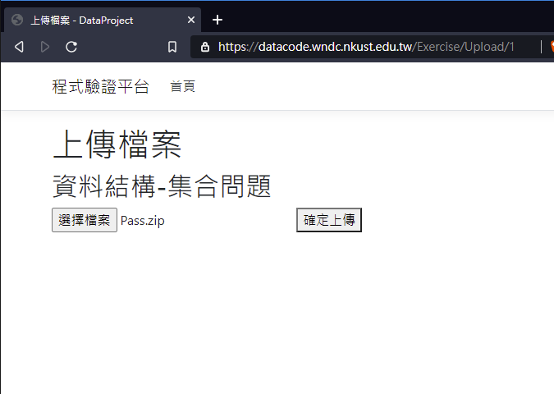
Instructions
Then click 確定上傳 button to submit the code.

Slide 14
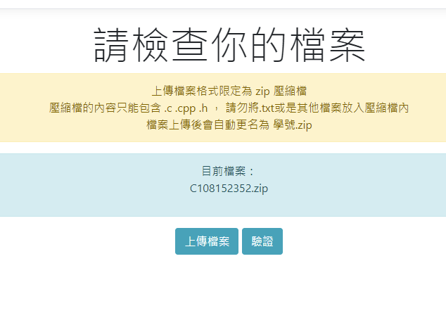
Instructions
Verify your code by clicking 驗證 button.

Slide 15
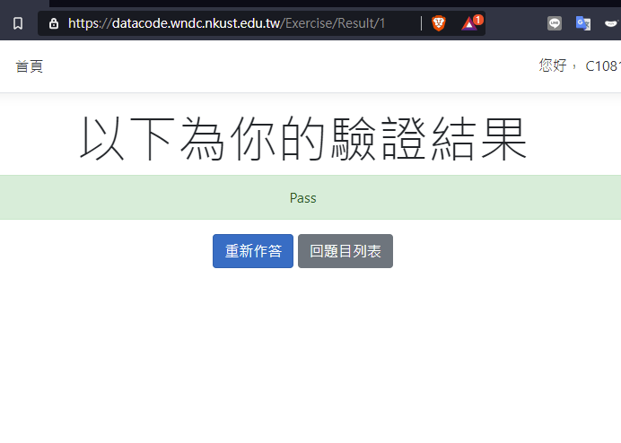
Instructions
The website will return the result.
Pass：It’s correct.
ResultError：Answer is not correct.
ExecutionError：Other errors, such as infinite loop.
CompileError：The code is compiled unsuccessfully.

Slide 16
Instructions
If you wanna re-verify the code, you can click 重新作答 button. Otherwise, clicking 回題目列表, it will return to the question list.

Slide 17
Notifications

Slide 18
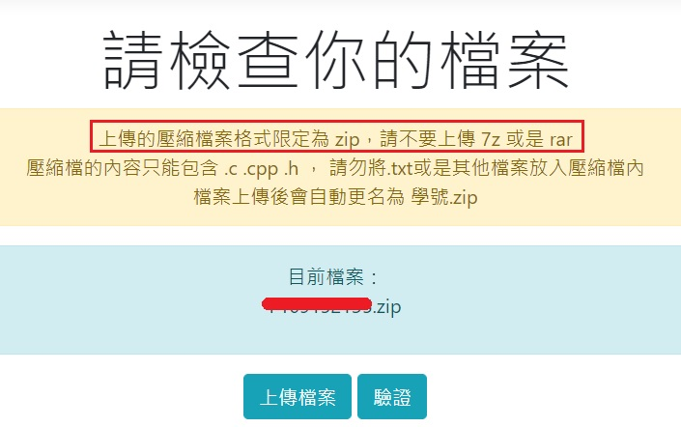
Notification - 1
Only zip file can be submitted to the website.

Slide 19
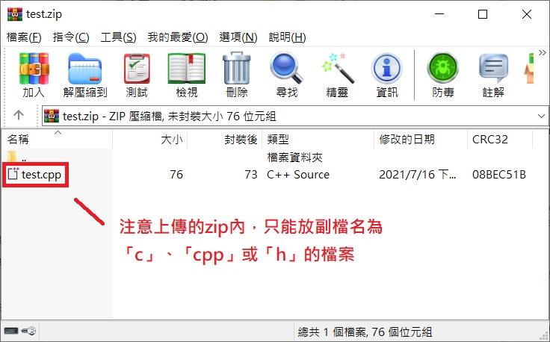
Notification - 2
Only the files with extensions 「c」, 「cpp」, or 「h」 can be zipped in the zip file.

Slide 20
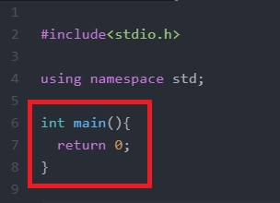
Notification - 3
If you use int main() in your code, note that you have use return 0 rather than other numbers to return the main function.
Reason：
return 0：Imply the function is successfully completed.
return 1： Imply the function is completed with failures.

Slide 21
Thanks for watching

